Slide 1
Caroline Herschel Gravity and Graphing

Slide 2
Planet | Diameter to the nearest 100km
Mercury | 4,900km
Venus. | 12,100km
Earth | 12,800 km
Mars | 6,800km
Jupiter | 143,000km
Saturn | 121,000km
Uranus | 51,100km
Slide 1

Slide 3
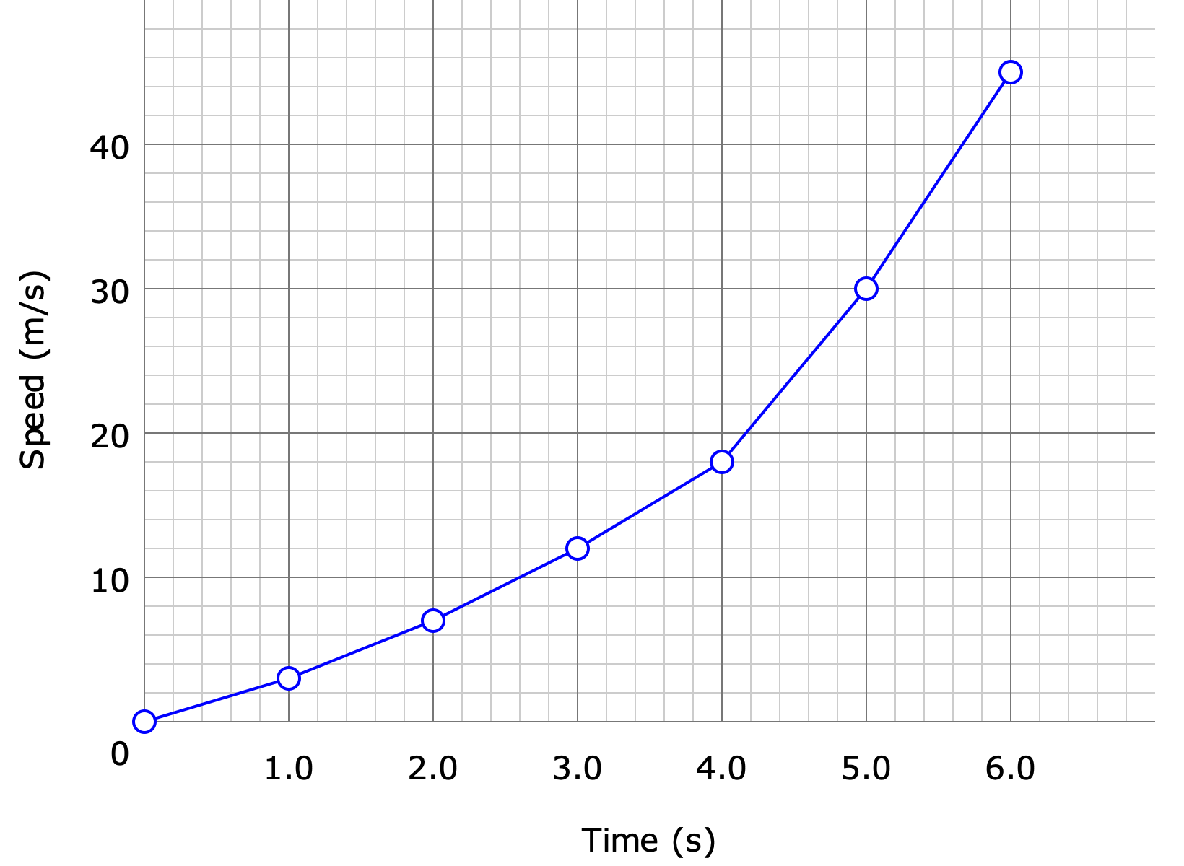
What kind of graph should we plot?
Slide 2

Slide 4
Slide 3

Slide 5
This is an ellipse.
Slide 4

Slide 6
How far away from the sun was Uranus?
Planet | Closest (million km) | Furthest (million km) | Average (million km)
Mercury | 46 million km | 70 million km | 57 million km
Venus | 107 | 109 | 108
Earth | 147 | 152 | 150
Mars | 205 | 249 | 228
Jupiter | 741 | 817 | 779
Saturn | 1,350 | 1,510 | 1,430
Uranus | 2,750 | 3,000 | 2,880
Slide 5

Slide 7
Extension
Slide 6

Slide 8
Photo Credits: Picture from Wikipedia - public domain
© HMDT Music 2020

